Slide 1
MAKE YOURSELF
AT HOME IN Savannah.

Slide 2
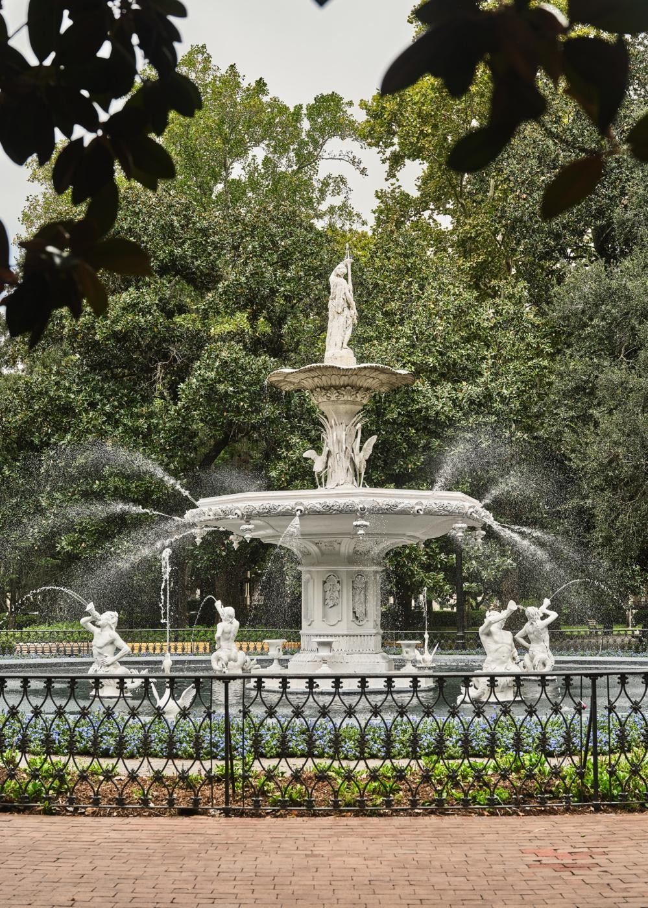
110 ANN ST. SAVANNAH, GEORGIA
912 - 446 - 1002
THEANNSAVANNAH.COM

Slide 3
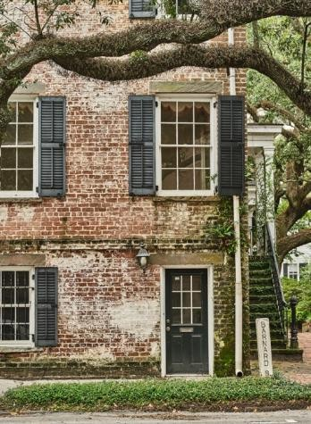

WELCOME TO
Georgia’s OLDEST AND
MOST STORIED CITY.

Slide 4
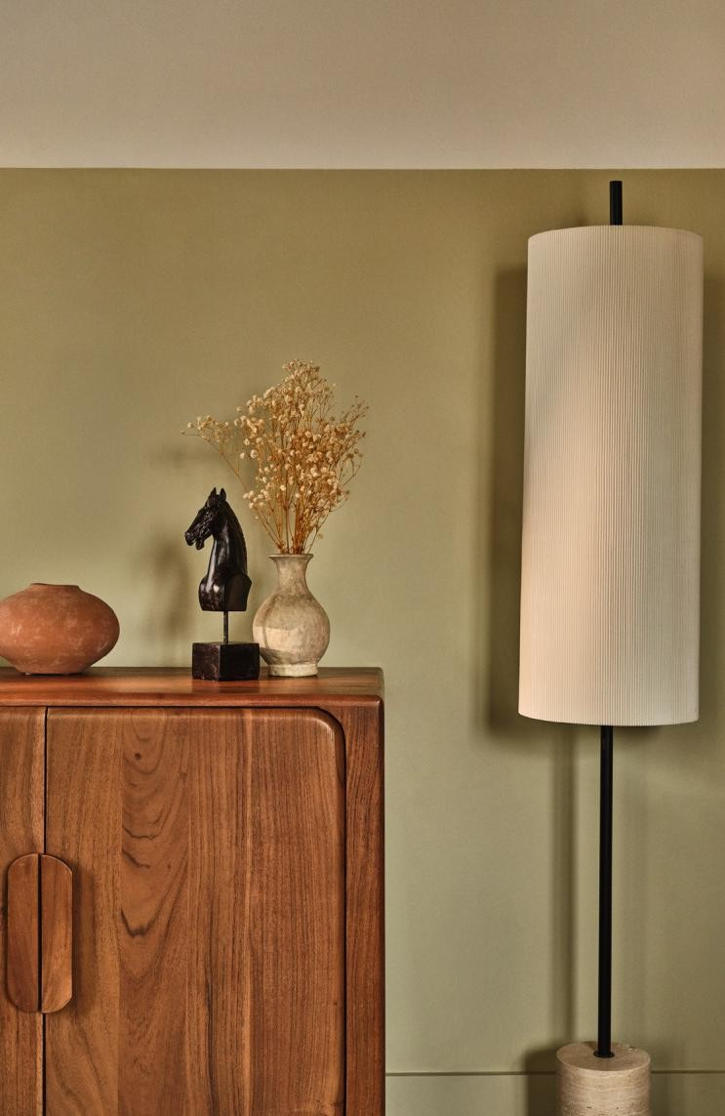
WELCOME Home
We are thrilled to have you with us and can’t wait for you to explore all that our beautiful city has to offer. From historic streets lined with charming architecture to lush squares and vibrant local culture, Savannah is a place where memories are made.
We encourage you to make yourself at home during your stay. Whether you’re unwinding in your suite, enjoying our amenities, or discovering nearby attractions, our home is your home while you are at The Ann.
Please reach out to the front desk for recommendations, assistance, or special requests. We’re here to help you make the most of your visit!
6
7

Slide 5
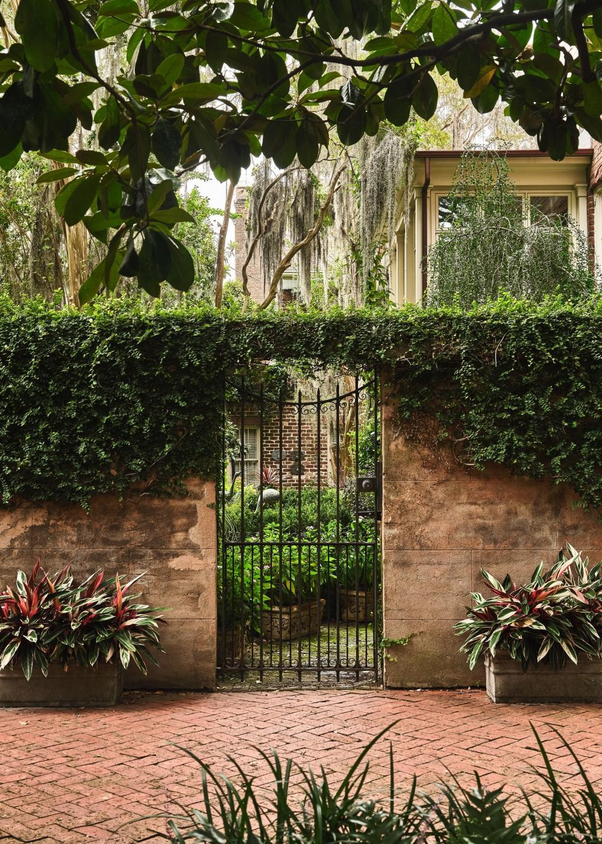
ARRIVAL &DEPARTURE
GUEST L O U N G E HOURS
The Guest Lounge is staffed 24/7 and can be contacted by using the speed dial on your suite telephone.
C H E C K IN
Check in begins at 4:00 PM
CHECK- OUT
Check out is at 11:00 AM
Early arrivals and late departures are accommodated based on availability.
To help us welcome our next guests in a timely manner, please be sure to load and run the dishwasher before departing. You can either check out through the Marriott Bonvoy App on your phone or stop by the Guest Lounge to say goodbye.
8
9

Slide 6
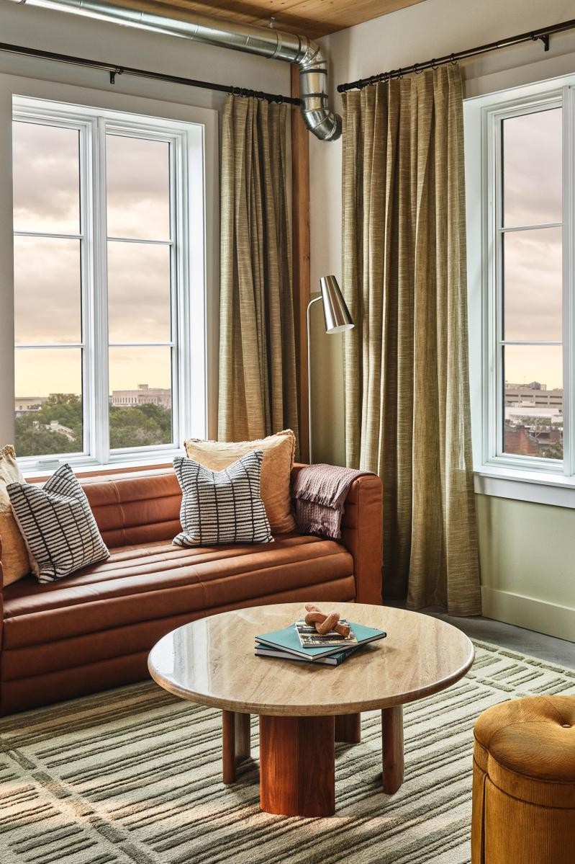
BEING A Good NEIGHBOR
QUIET HOURS
To ensure peaceful rest for all our guests, quiet hours are from
10:00 PM to 7:00 AM each night.
PETS
We’re delighted to welcome your furry friends! Please remember to register your pet with the front desk upon check in so we can ensure a comfortable stay for all. A $100 non-refundable pet fee will be applied to your stay. Additionally, please be sure to hang the pet-in-room tassel on the outside of your door at all times.
SMOKING POLICY
The Ann is a 100% non-smoking hotel. A fee of $250 per night will
be applied if smoking is detected.
10
11

Slide 7

AMENITIES
In order to make you feel at home, our team has curated amenities for an enjoyable and comfortable stay at The Ann. Our destination amenity fee includes access to all of the following amenities.
FITNESS CENTER
Our fully equipped fitness center, conveniently located on the ground floor, features a spacious design with sunlight pouring in through the large windows. The space is exclusively for guests and accessible 24/7.
CO-WORKING SPACES
Our building has multiple co-working spaces to help you stay on top of your tasks. The co-working space on the ground floor, adjacent to the Guest Lounge, is equipped with a large co-working table, soft seating, and a multitude of outlets for charging. If you’re feeling like a breath of fresh air, the Wi-Fi extends into our courtyard, a tranquil place to get work done.
BICYCLES
We are delighted to offer our guests complimentary use of our bikes to explore the city. Simply speak with the front desk agent to borrow a bike, helmet, and lock for 2 hours—available on a first-come, first-served basis.
LAUREL MARKET
Located on the ground floor next to the Guest Lounge, Laurel Market is open 24 hours a day selling food, drinks, and sundries.
12
13

Slide 8
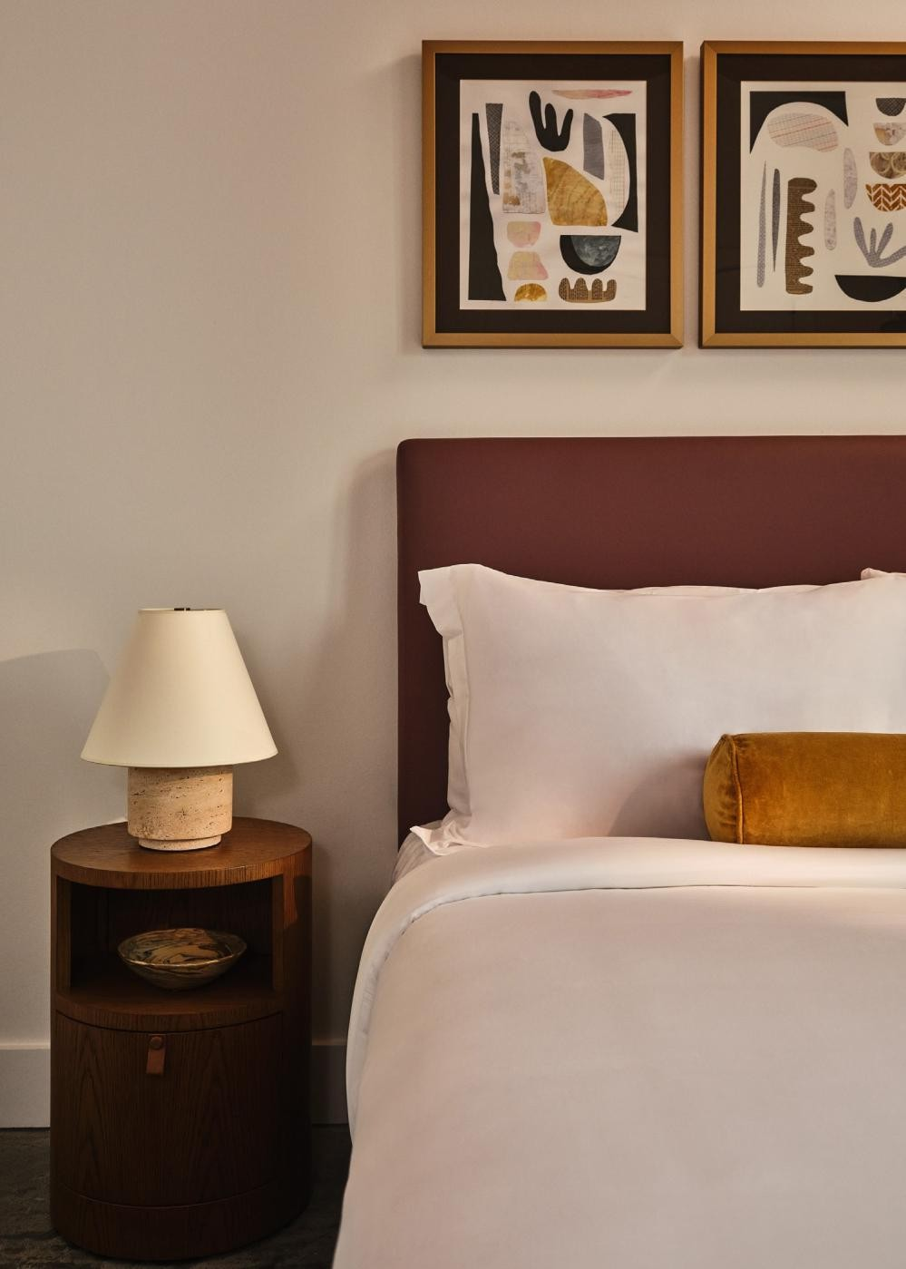
HOUSEKEEPING
CLEANING SUPPLIES
A variety of cleaning supplies for your use can be found under the kitchen sink. Additional items are available for purchase at Laurel Market.
HOUSEKEEPING SERVICES
Housekeeping will service your suite 7 days after check in. If you do not want housekeeping services, please hang the do not disturb door hanger outside of your suite.
14
15

Slide 9
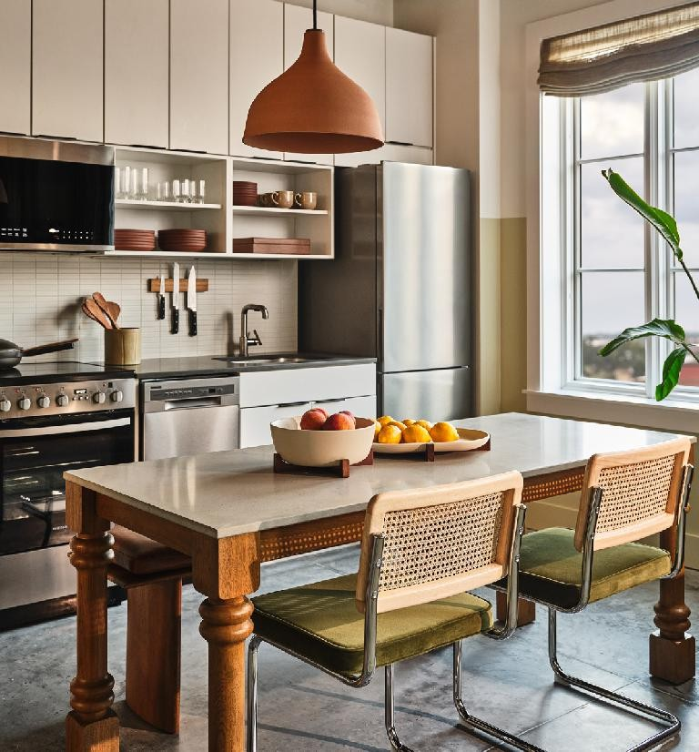
KITCHEN
ESPRESSO & TEA BREWER
Start your day off with a fresh cup of espresso or tea from the comfort of your suite. To use, fill the water reservoir in the back of the brewer, open the sliding door top to insert the capsule, close
the sliding door, and hold down your drink selection button to start brewing. We have provided you with capsules to get started and more are available for purchase at Laurel Market.
OVEN-TO-TABLE DISHWARE
To make cooking a breeze, the kitchen is equipped with an oven-to-table serving tray and bowl. The dishes are dishwasher, microwave and oven safe up to 400°F. Each come with a wooden trivet to beautifully display your meal and protect the countertops.
OUR PLACE PAN
Enjoy cooking with the Our Place pan which sautes, fries, roasts, boils, bakes, braises, sears, strains, serves, stores. It’s ceramic coating is free of toxins and is oven safe up to 450°F. It is recommended to hand wash with a sponge only after the pan is fully cooled and to cook on low-medium heat to preserve the nonstick coating.
ICE TRAY
Keep your drinks cold with the ice tray and bin located in the freezer.
STEP STOOL STORAGE
For your convenience, a step stool is available in the closet to help
you reach the upper kitchen cabinets.
16
17

Slide 10
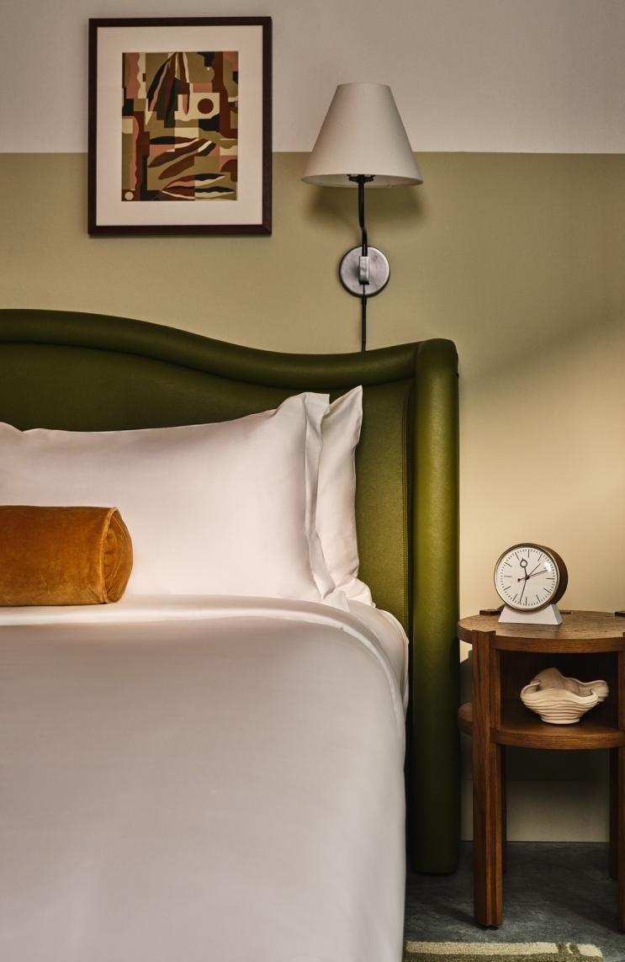
SUITE Features
WI-FI
Network: Marriott GPNS
Once you select the network, a web page will pop up. Follow the
prompts to login.
TV
Login to your Netflix account to pick up where you left off. If you don’t have an account, that’s not a problem. Our TVs also have cable.
ALARM CLOCK
Each bedroom has its own alarm clock to keep you on schedule.
18
19

Slide 11
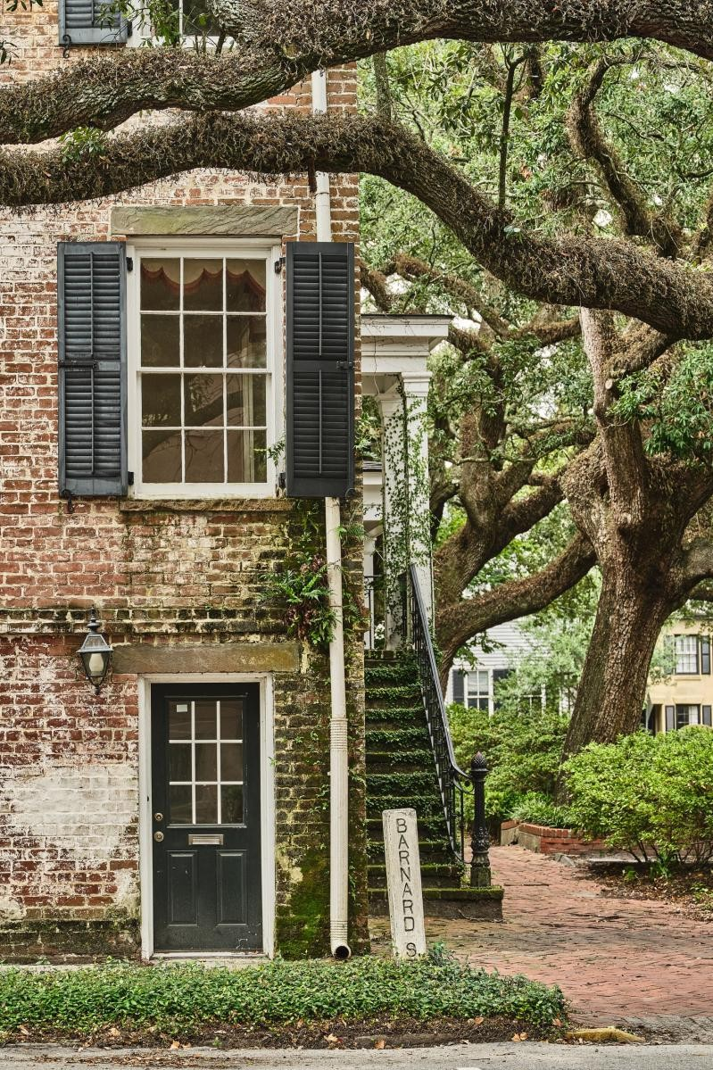
PACKAGE Deliveries
All packages will be securely delivered to the package storage behind the front desk. If you’re expecting a delivery, please go to the Guest Lounge to retrieve your package.
For proper delivery, please use the address provided below:
110 Ann St Savannah, GA 31401
20
21

Slide 12
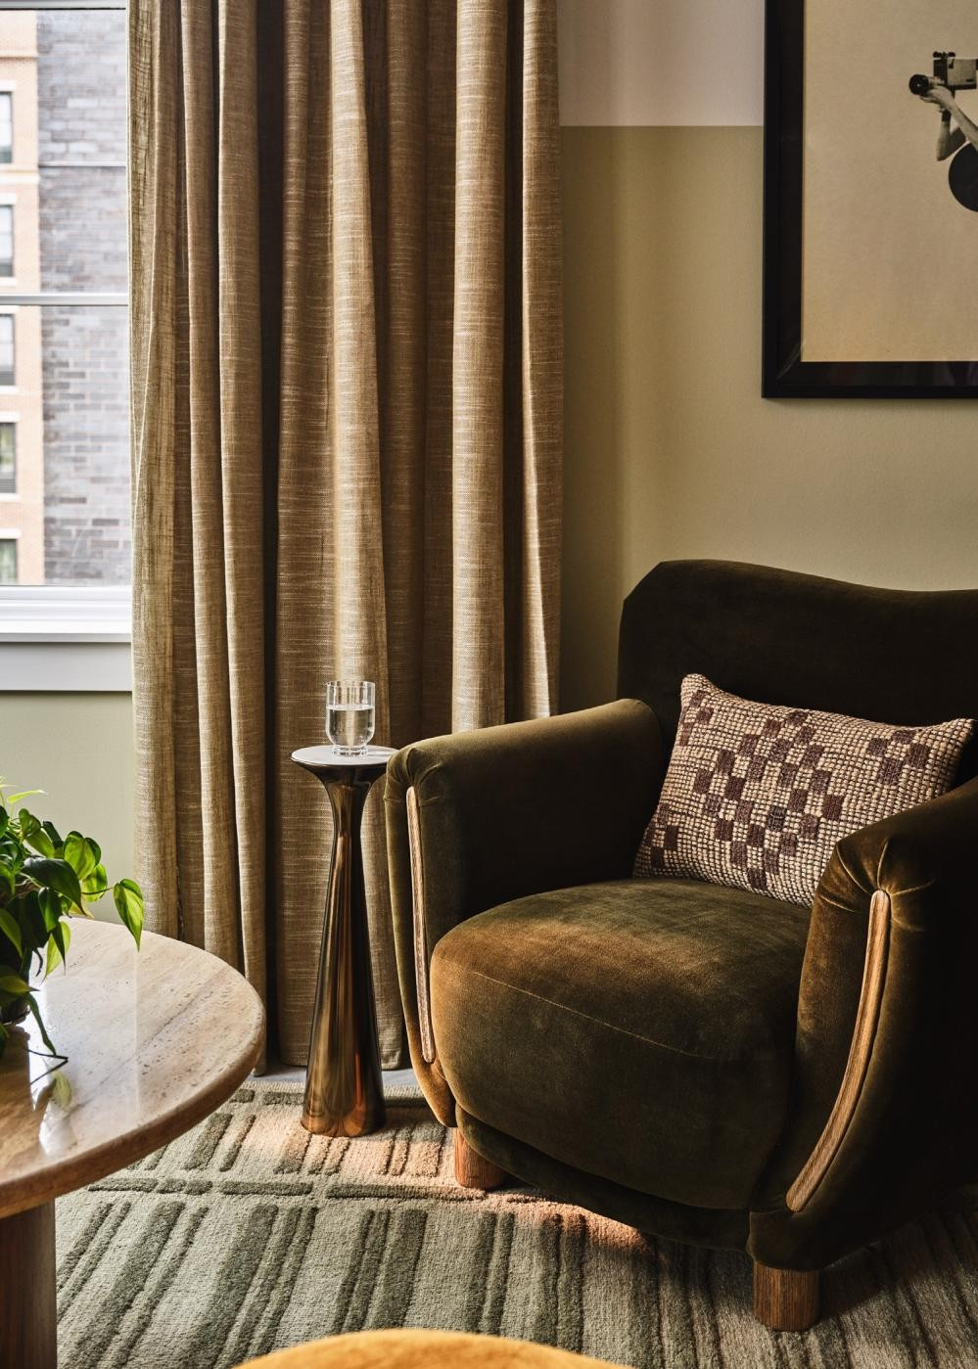
LAUNDRY &DRY CLEANING
WASHER AND DRYER
Your suite is equipped with a washer, dryer and laundry basket.
DRY CLEANING SERVICES
If your clothes require a little extra care, the nearest dry cleaner is a
7 minute drive away.
Hall street Laundry and Dry Clean 704 Abercorn St, Savannah, GA 31401 912-238-3690
22
23

Slide 13
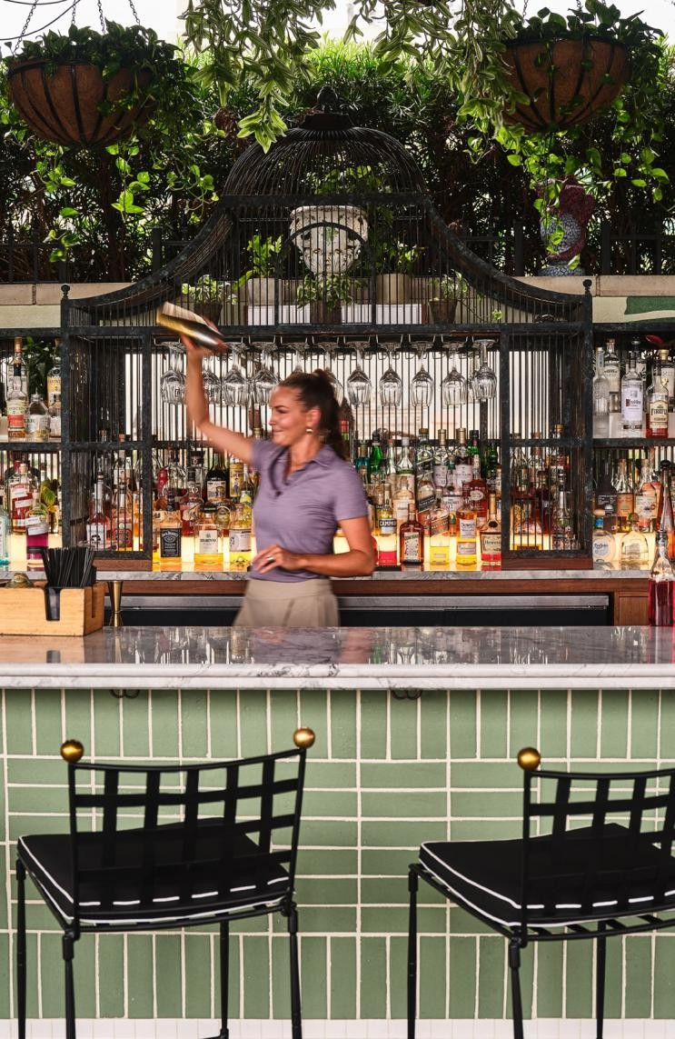
TELEPHONE
Each suite is equipped with a telephone. In order to place an outside call, press 9, wait for the dial tone and then enter the phone number of who you wish to call.
FOR EMERGENCIES
Dial 911
24
25

Slide 14
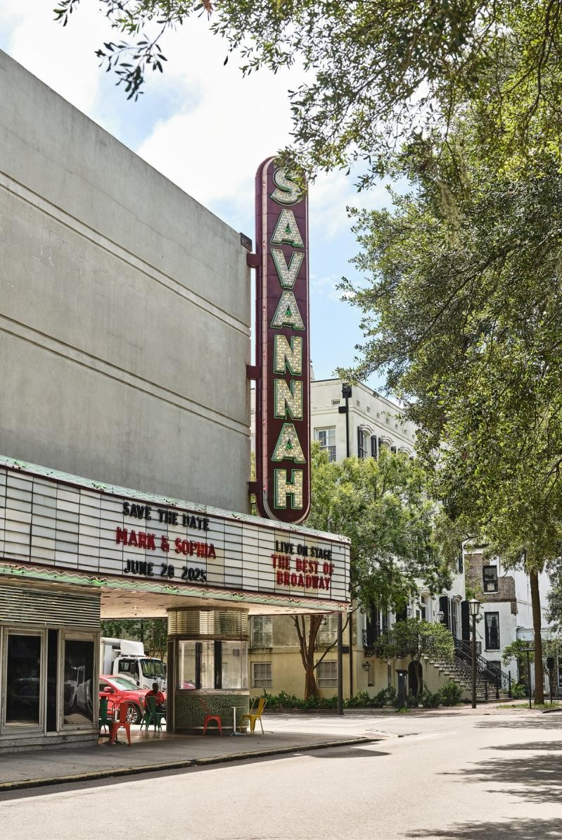
TRANSPORTATION &
PARKING
PARKING
Overnight valet parking is available for a daily fee, including full
in-and-out privileges at no charge. There are self-parking options in
nearby parking garages; however, in-and-out charges will apply.
RIDE- SHARE SERVICES
Uber and Lyft are readily available throughout the city, providing a convenient and reliable transportation option to take you wherever you need to go.
SAVANNAH PEDICAB
Savannah Pedicab is another fun way to explore Savannah. Call 912-232-7900 or visit savannahpedicab.com to book a ride.
BICYCLES
We are delighted to offer our guests complimentary use of our bikes to explore the city. Simply speak with the front desk agent to borrow a bike—available on a first-come, first-served basis.
26
27

Slide 15
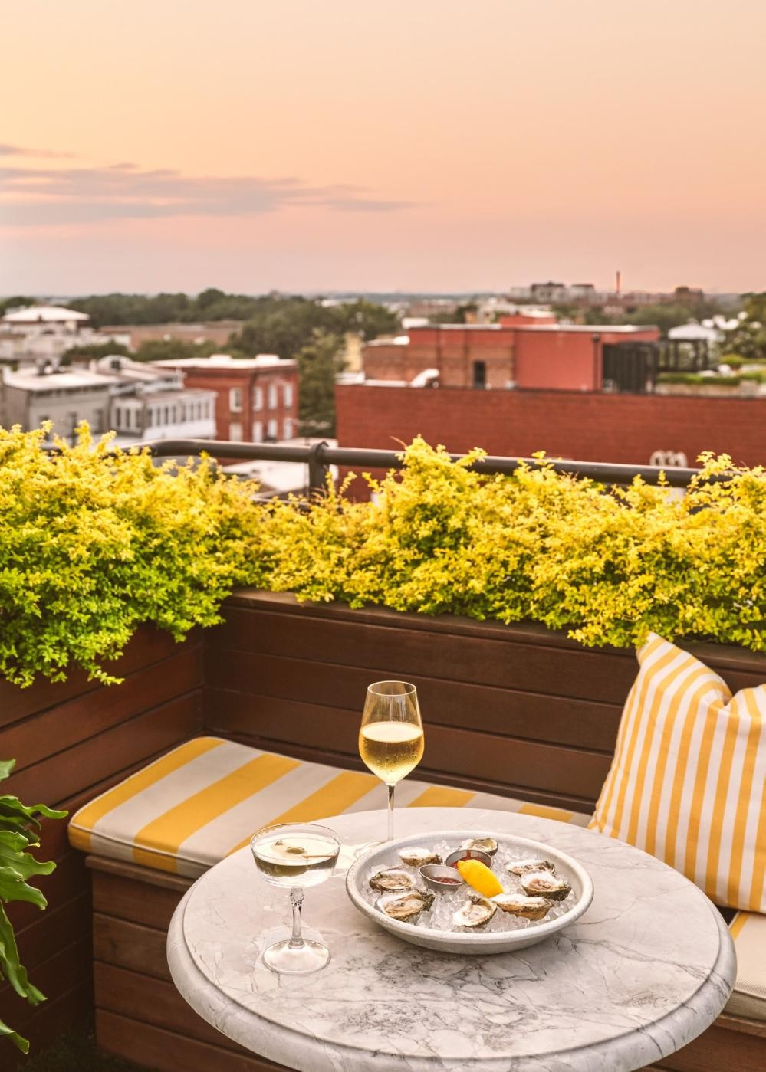
FROM Here TO There
SCAD Museum of Art
0.2 miles | 2 minute drive | 7 minute walk
River Street
0.3 miles | 3 minute drive | 8 minute walk
Forsyth Park
mile | 6 minute drive | 22 minute walk
Savannah/Hilton Head International Airport
10.4 miles | 20 minute drive
Tybee Island
18 miles | 30 minute drive
Hilton Head Island
33 miles | 45 minute drive
Charleston
108 miles | 2 hour drive
28
29

Slide 16




















EXPLORING Savannah
River Street
W BAY ST
W BAY ST
RESTAURANTS
SHOPPING
City Market
Byrd’s Famous Cookies
Savannah Bee Company
The Paris Market
Doki Doki Ice Creamery
Chocolat by Adam Turoni
Satchel
E. Shaver Booksellers
ShopSCAD
One Fish Two Fish
D R A Y T O N ST
E B R Y AN ST
Little James
The Emporium Kitchen + Wine Market
The Collins Quarter
Husk Savannah
Mrs. Wilkes Dining Room
The Grey
Dottie’s Market Savannah
The Olde Pink House
Treylor Park
A N N S T
W C O N G R E S S S T
W BR O UG HT O N ST
BULL ST
E B R O U G H T O N ST
J E F FE R S O N S T
W S T A T E S T
M A R T I N L U T H E R K I N G J R B L V D
BULL ST
E OGLETHORPE AVE
M O N TG O M E R Y S T
Colonial Park Cemetery
LIBERTY ST
W H I TA K ER S T
D R A Y T O N ST
LIBERTY ST
Rhett
The Public Kitchen & Bar
PRICE ST
ARTS &
ENTERTAINMENT
American Prohibition Museum
Telfair Academy
Jepson Center & Telfair Children’s Art Museum
SCAD Museum of Art
Mercer Williams House
Museum
W C H A R L T O N S T
E C H A R L T O N S T
BARS
Peregrin Rooftop Bar
The Wayward
Artillery
The Alley Cat Lounge
The Peacock Lounge
Myrtle & Rose Rooftop Bar
BULL ST
W T A Y L O R S T
E T A Y L O R ST
W G O R D O N S T
E G O R D O N S T
E G A S T O N ST
RESTAURANTS
BARS
C OF FEE & TEA
PARKS &
SIGHTSEEING
River Street
Chippewa Square
Colonial Park Cemetery
Forsyth Park
W H I T A K E R ST
D R A Y T O N ST
COFFEE & TEA
The Coffee Fox
Bitty & Beau’s Coffee
Savannah Tea Room
Ashford Tea Company
SHOPPING
For more information on all that Savannah has to offer, please scan the QR code.
ARTS & ENTERTAINMENT
Forsyth Park
PARKS & SIGHTSEEING
30
31

Slide 17
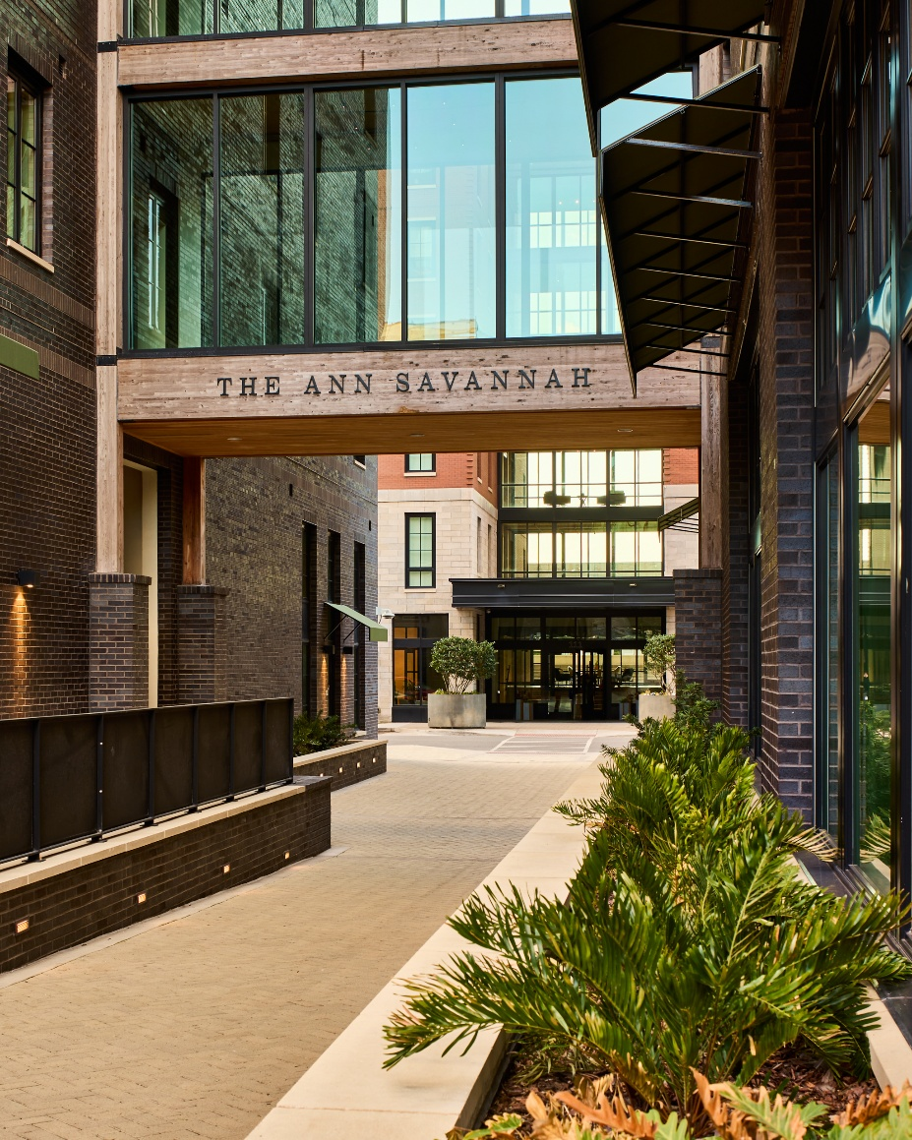
Enjoy YOUR STAY
Thank you for choosing to stay with us at The Ann! We hope you feel right at home and enjoy every moment of your time in Savannah.
If there’s anything we can do to make your stay more comfortable, please don’t hesitate to let us know. Feedback is important to us and we welcome any questions, comments, or concerns.
Phone: 912-446-1002
Email: info@theannsavannah.com
If you wish to learn more about Apartments by Marriott Bonvoy, please visit the Our Brands tab on the Marriott.com website.
32
33

Slide 18
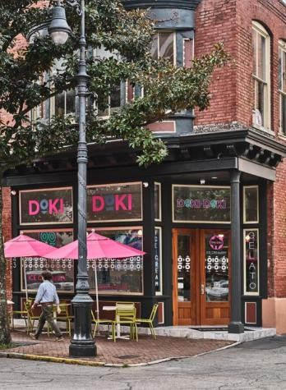
EVERYTHING
Savannah HAS TO OFFER IS AT
YOUR DOORSTEP.
34
35

Slide 19
THEANNSAVANNAH.COM

